Slide 1
STEM
hands-on problem solving, content connected, collaboration, applied knowledge

Slide 2
Amazing Animals
Animals have special body parts that help them do amazing things. This week, we will learn about different animals and their special features. Do you know why turtles have a hard shell? Can you design a shell to protect a turtle?

Slide 3
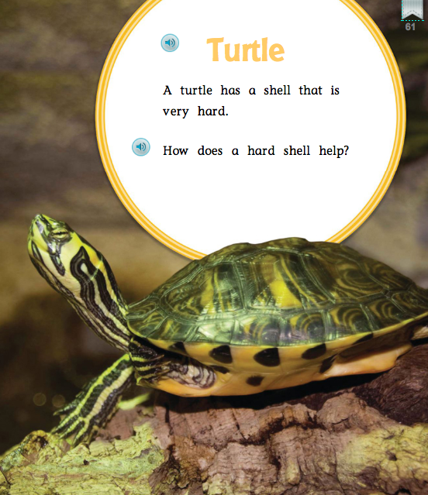
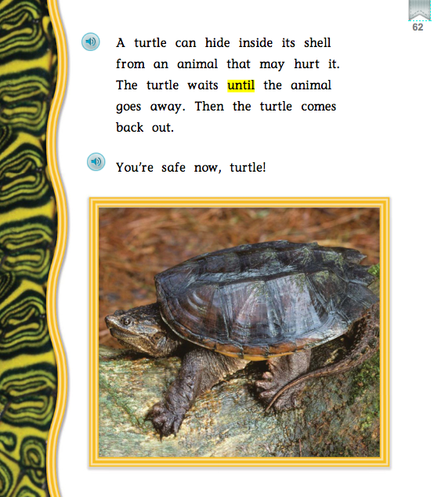
Amazing Animals

Slide 4
Challenge
Design a shell to protect your turtle body (play doh ball)
Shell must have:
Holes for head, legs, and tail
Top and bottom protection

Slide 5
Engineering Design Process
Ask- Monday: Read Amazing Animals, explore real turtle shells
Imagine/Plan- Tuesday: View materials, plan and sketch
Create- Wednesday: build shells
Improve- Thursday: finish building and test shells
Present- Friday: complete rubric, present shells defend choices

Slide 6
Supplies Needed
Paper plates (small)
Foam plates (small)
Dixie cups
Cardboard tubes
Paper bowls
Aluminum foil
Pie tins (small)
Popsicle sticks
Adhesives:
Glue
Tape (1 foot)
Pipe cleaners
Brads
Green playdoh (turtle body)
Tennis ball (for testing)

Slide 7
Let’s Go To the Moon
Astronauts use tools to do special jobs on the moon. This week, we will learn about space exploration, vehicles, and tools. Do you know why astronauts collect objects on the moon? Can you design a robo-arm to collect a moon rock?

Slide 8
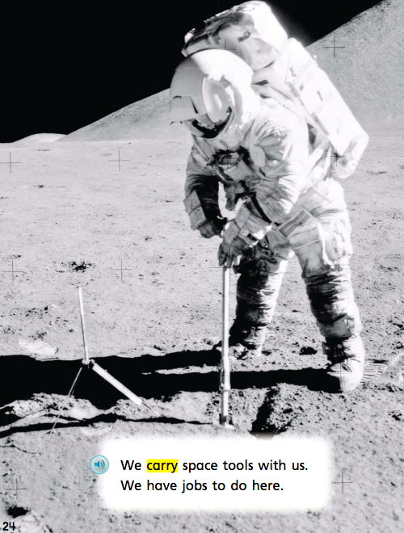
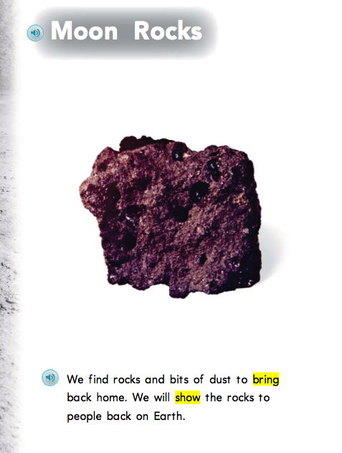
Let’s Go To the Moon

Slide 9
Challenge
Design a robo arm to collect a moon rock (jewel stone)
Arm must have:
Enough length to reach object without leaving “rocket”
Tool at tip to collect object

Slide 10
Engineering Design Process
Ask- Monday: Read Let’s Go To the Moon, explore videos of space exploration
Imagine/Plan- Tuesday: View materials, plan and sketch
Create- Wednesday: build robo arms
Improve- Thursday: finish building and test arms
Present- Friday: complete rubric, present arms and defend choices

Slide 11
Supplies Needed
Cardboard tubes
(various sizes)
Cardboard scraps
(various sizes)
Popsicle sticks
(various sizes)
Plastic Spoons
Plastic Forks
Adhesives:
Glue
Tape (1 foot)
Pipe cleaners
Brads
Yarn
Jewel rocks (moon rock)
Sand (for moon surface)

Slide 12
Questions?
Does this sound reasonable?
Concerns?
Needs?

Slide 13
Are you ready to start planning?
Grab your basal series or materials used to develop lessons.
Meet with your grade level team. K or 2nd, who is willing to volunteer to work through building a STEM challenge?
(mock meeting)
How can we help?
Contact: Dee Dulin dee.dulin@maryville-schools.org
Miranda Reagan miranda.reagan@maryville-schools.org

